Slide 1
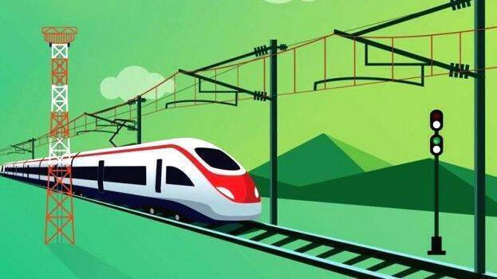

PROJECT REPORT ON
“The fastest stop of a train at a station”
Submitted by: Sarthak Singh
Enxhi Sabrija
Bhargav Ramudu MANAM
Mayank Raj Jha
MENTOR : Dr. Adeleke O. Bankole
Prof. Dr. Ingenuin Gasser

Slide 2
Content
Theory
Objective
Introduction
Mathematical Modelling
Analytical Explanation
Phase Portrait of Hamiltonian Function & Switching Curve
Simulink Model & Results
Implementation in MATLAB & Results
Application & Product Quality
Conclusion
References

Slide 3

Theory
Pontryagin Principle:
For deterministic dynamics $\dot{x}=f(x,u)$ we can compute extremal open-loop trajectories (i.e. local minima) by solving a boundary-value ODE problem with given x (0) and $λ\left(T\right)=\frac{∂q_{T}(x)}{∂x}$ where λ (t) is the gradient of the optimal cost-to-go function (called costate).
Continuous-time maximum principle:
If x (t), u (t), 0 $≤$t $≤$T is the optimal state-control trajectory starting at x (0), then there exists a costate trajectory λ (t) with $λ\left(T\right)=\frac{∂q_{T}(x)}{∂x}$ satisfying
$$\dot{x}=\overline{H_{λ}}\left(x,u,λ\right)=f(x,u)$$
$$−\dot{λ}=\overline{H_{x}}\left(x,u,λ\right)=l_{x}\left(x,u\right)+f_{x}{\left(x,u\right)}^{T}λ$$
$$u=\arg{\min_{\tilde{u}}{\overline{H}(x,\tilde{u},λ)}}$$
Discrete-time maximum principle:
If $x_{k},u_{k}, 0≤k≤N$is the optimal state-control trajectory starting at $x_{0}$, then there exists a costate trajectory $λ_{k}$with $λ_{N}=\frac{∂}{∂x}q_{T}$($x_{N})$ satisfying
$$x_{k+1}= \overline{H_{λ}}\left(x_{k},u_{k},λ_{k+1}\right)=f(x_{k},u_{k})$$
$$λ_{k}= \overline{H_{x}}\left(x_{k},u_{k},λ_{K+1}\right)= l_{x}\left(x_{k},u_{k}\right)+f_{x}(x_{k},u_{k})^{T}λ_{k+1}$$
$$u_{k}=\arg{\min_{\tilde{u}}{\overline{H}(x_{k},\tilde{u},λ_{k+1})}}$$

Slide 4

Theory
Filippov’s Theorem: Let the space of control parameters $U∈ℝ^{m}$be compact. Let there exist a compact $K∈M$ such that $f_{u}\left(q\right)=0 for q∉K, u∈U$. Moreover, let the velocity sets
$f_{u}\left(q\right)=\left\{f_{u}\left(q\right) | u∈U\right\}⊂T_{q}M, q∈M$
be convex. Then the attainable sets $A_{q_{0}}(t)$ & $A_{q_{0}}^{t}$ are compact for all $q_{0}∈M, t>0$.
Bang-Bang Control : Bang-bang control is a type of control system that mechanically or electronically turns something on or off when a desired target (setpoint) has been reached. Bang–bang controllers, which are also known as two-step controllers, on-off controllers or hysteresis controllers, are used in many types of home and industrial control systems (ICS).

Slide 5
Objective
The problem is to drive the train to a station and stop it there in a minimal time.
Solving the problem mathematically
Explanation of the problem analytically
Implementation of the problem in MATLAB & Simulink.

Slide 6

Introduction
The problem is to drive the train to a station and stop it there in a minimal time.
Denote: Assumption:
Position of the train$→$ x₁ , $x_{1}∈ℝ$ The train moves without friction,
Station where the train will stop$→$ The origin 0 $∈$ $ℝ$ Controlled acceleration $\left|u\right|≤1$
Acceleration$→$u
We obtain the control system:
$\ddot{x_{1}}=u, { x}_{1}∈ℝ, \left|u\right|≤1$
Standard form:
$\begin{matrix}\dot{{ x}_{1}}=x_{2}, \\ \dot{x_{2}}=u,\end{matrix} x=\left(\begin{matrix}x_{1} \\ x_{2}\end{matrix}\right) ∈ ℝ^{2}, \left|u\right|≤1$ (1)
The time-optimal control problem:
$x\left(0\right)= x^{0}, x\left(t_{1}\right)=0 \left(2\right)$
$t_{1}⟶ min. (3)$

Slide 7

Mathematical Modelling
1. Verify existence of optimal controls by Filippov’s theorem:
The set of control parameter U = [-1,1] is compact, the vector fields in the right-hand side
$$f\left(x,u\right)=\left(\begin{matrix}x_{2} \\ u\end{matrix}\right), \left|u\right| ≤1,$$
are linear and the set of admissible velocities at a point is convex
$$f\left(x,U\right)=\{f\left(x,u\right) | \left|u\right| ≤1,$$
The time-optimal control problem has a solution if the origin 0 ∈ $ℝ^{2}$ is attainable from the initial point $x^{0}.$

Slide 8

Mathematical Modelling
2. Applying Pontryagin Maximum Principle:
Introduce canonical coordinates on the cotangent bundle:
M = $ℝ^{2},$
T*M = T* $ℝ^{2}$ = $ℝ^{2∗}×$ $ℝ^{2}$ = $\left\{λ=\left(ξ,x\right)\right| x=\left(\begin{matrix}x_{1} \\ x_{2}\end{matrix}\right), ξ=(ξ_{1},ξ_{2})\}$
The control dependent Hamiltonian function of PMP is
$h_{u}\left(ξ,x\right)=\left(ξ_{1},ξ_{2}\right)\left(\begin{matrix}x_{2} \\ u\end{matrix}\right)= ξ_{1}x_{2}+ξ_{2}u$
and the corresponding Hamiltonian system has the form
$$\dot{x}= \frac{{δh}_{u}}{δξ} , \dot{ξ}= −\frac{{δh}_{u}}{δx}$$
In coordinates this system splits into two independent subsystems:
$$\left\{\begin{matrix}\dot{x_{1}}=x_{2} \\ \dot{x_{2}}=u\end{matrix}\right\} , \left\{\begin{matrix}\dot{ξ_{1}}=0 \\ \dot{ξ_{2}}= −ξ_{1}\end{matrix}\right\} (4)$$

Slide 9

Mathematical Modelling
By PMP, if a control $\tilde{u}(.$) is time optimal, the Hamiltonian system has a nontrivial solution
$\left(ξ\left(t\right),x\left(t\right)\right), ξ\left(t\right)≢0$
$$h_{\tilde{u}\left(t\right)}\left(ξ\left(t\right),x\left(t\right)\right)=\max_{|u|≤1}{h_{u}(ξ\left(t\right),x\left(t\right))≥0}$$
From this maximality condition if $ξ_{2}\left(t\right)≠0,$ then
$\tilde{u}\left(t\right)=sgnξ_{2}\left(t\right).$
Since $\ddot{ξ_{2}}=0 → ξ_{2}(t)$= $α+β(t)$ , $α, β=const.$
Hence, the optimal control is:
$\tilde{u}\left(t\right)=\operatorname{sgn}\left(α+βt\right)$
$\tilde{u}\left(t\right)$Piecewise constant( u= $∓1 )$
$\tilde{u}\left(t\right)$ has not more than one switching.

Slide 10

Mathematical Modelling
3. Finding all trajectories x(t) that correspond to such controls and come to the origin.
For controls u = $∓1$ the first of subsystems (4) reads
$$\left\{\begin{matrix}{\dot{x}}_{1}=x_{2}, \\ {\dot{x}}_{2}=±1\end{matrix}\right.$$
Trajectories of this system satisfy the equation
$\frac{ⅆx_{1}}{ⅆx_{2}}=±x_{2},$
thus are parabolas of the form
$$x_{1}=±\frac{x_{2}^{2}}{2}+c, c=const.$$
i) Finding trajectories from this family that come to the origin without switchings :
$x_{1}=\frac{x_{2}^{2}}{2} , x_{2}<0, {\dot{x}}_{2}>0,$ (5)
And
$x_{1}=−\frac{x_{2}^{2}}{2} , x_{2}>0, {\dot{x}}_{2}<0,$ (6)
for u =+1 and -1 respectively.

Slide 11

Mathematical Modelling
ii) Find all extremal trajectories with one switching.
Let $\left(x_{1s},x_{2s}\right)∈ℝ^{2}$ be a switching point for anyone of curves (5),(6).
Extremal trajectories with one switching coming to the origin have the form:
$x_{1}=\left\{ \begin{matrix}−\frac{x_{2}^{2}}{2}+\frac{x_{2s}^{2}}{2}+x_{1s, } { x}_{2}>x_{2s, }{\dot{x}}_{2}<0, \\ \frac{x_{2}^{2}}{2} 0>x_{2}>x_{2s},{ \dot{x}}_{2}>0,\end{matrix}\right.$ (7)
And
$x_{1}=\left\{ \begin{matrix}\frac{x_{2}^{2}}{2}−\frac{x_{2s}^{2}}{2}+x_{1s, } { x}_{2}<x_{2s, }{\dot{x}}_{2}>0, \\ − \frac{x_{2}^{2}}{2} 0<x_{2}<x_{2s},{ \dot{x}}_{2}<0,\end{matrix}\right.$ (8)

Slide 12
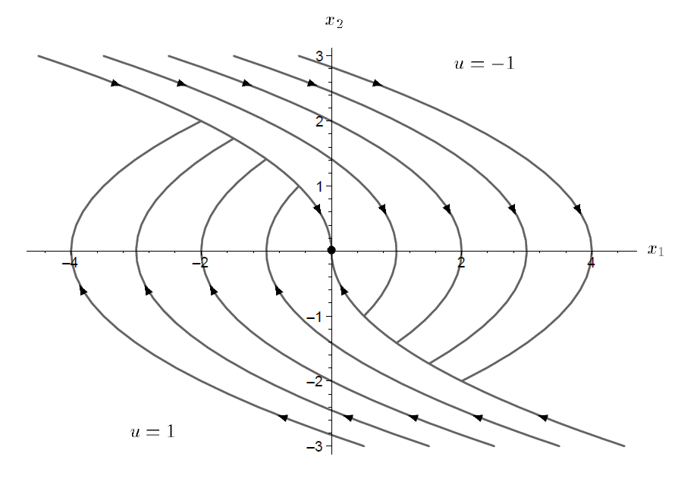
General view of the optimal synthesis
Optimal trajectories exist Solutions are optimal

Slide 13

Analytical Explanation
Given the system;
$\ddot{x}(t)=\left(\begin{matrix}\dot{x_{1}}(t) \\ \dot{x_{2}}(t)\end{matrix}\right)=\left(\begin{matrix}0 & 1 \\ 0 & 0\end{matrix} \right)\left(\begin{matrix}x_{1}(t) \\ x_{2}(t)\end{matrix}\right)+\left(\begin{matrix}0 \\ 1\end{matrix}\right)u(t)$
A x(t) B u(t)
With the performance index $J= \int_{0}^{t_{f}}{dt}=t_{f}$is minimized with $\left|u\left(t\right)\right|≤1$
Sol. $H\left(.\right)=1+ λ^{T}\left(t\right)\left[Ax\left(t\right)+Bu\left(t\right)\right]$
$H\left(.\right)=1+\left[λ_{1}\left(t\right):λ_{2}\left(t\right)\right]\left[\left(\begin{matrix}0 & 1 \\ 0 & 0\end{matrix}\right)\left(\begin{matrix}x_{1}(t) \\ x_{2}(t)\end{matrix}\right)+\left(\begin{matrix}0 \\ 1\end{matrix}\right)u(t)\right]$
$H\left(.\right)=1+\left[λ_{1}\left(t\right)+λ_{2}\left(t\right)\right]\left[\begin{matrix}x_{2}\left(t\right) \\ u\left(t\right)\end{matrix}\right]$
$H\left(.\right)=1+λ_{1}\left(t\right)x_{2}\left(t\right)+λ_{2}\left(t\right)u(t)$ (1)

Slide 14


Analytical Explanation
Co-state Equations are
$\dot{λ}\left(t\right)=−\frac{∂H\left(.\right)}{∂x\left(t\right)}=−\left[\begin{matrix}0 \\ λ_{1}\left(t\right)\end{matrix}\right]$
$\dot{λ_{1}}\left(t\right)=0$ (2)
$\dot{λ_{2}}(t)=−λ_{1}(t)$ (3)
From (2), $\frac{{dλ}_{1}}{dt}=0⟶λ_{1}\left(T\right)=λ_{1}\left(0\right)$ (4)
From (3) $\dot{λ_{2}}\left(t\right)=−λ_{1}\left(t\right)=−λ_{1}(0)$
$\frac{{dλ}_{2}(t)}{dt}$= - $λ_{1}\left(0\right), λ_{2}\left(t\right)=−λ_{1}\left(0\right)t+λ_{2}\left(0\right)$ (5)
From (1) $H\left(.\right)=1+λ_{1}\left(t\right)x_{2}\left(t\right)+λ_{2}\left(t\right).u(t)$
$u^{∗}(t)=1 if λ_{2}\left(t\right)<0$
$=−1 if λ_{2}\left(t\right)>0$
$u^{∗}\left(t\right)=−sign\left(λ_{2}\left(t\right)\right)=−sign(λ_{2}\left(0\right)−λ_{1}\left(0\right)t)$
$Sign= 1 if z>0$
$−1 if z<0$
U(t)
1
0
$$λ_{2}\left(t\right).$$
-1

Slide 15

Analytical Explanation
$u^{∗}(t)$ =1
$\dot{x_{1}}\left(t\right)=x_{2}\left(t\right), \dot{x_{2}}\left(t\right)=1, x_{2}\left(t\right)=t+ x_{2}(0)$
$\dot{x_{1}}\left(t\right)= x_{2}\left(0\right)+t$
$x_{1}\left(t\right)=\frac{t^{2}}{2}+x_{2}\left(0\right)+x_{1}\left(0\right)$
$x_{1}\left(t\right)=x_{1}\left(0\right)+x_{2}\left(0\right).t+\frac{t^{2}}{2}$
$x_{1}\left(t\right)=x_{1}\left(0\right)+x_{2}\left(0\right)\left(x_{2}\left(t\right)−x_{2}\left(0\right)\right)+\frac{(x_{2}\left(t\right)−x_{2}(0))^{2}}{2}$
$x_{1}\left(t\right)=\frac{x_{2}^{2}(t)}{2}+\frac{x_{2}^{2}(0)}{2}+x_{1}\left(0\right)→for u=+1$ (6)
for $u^{∗}\left(t\right)=−1$, the state equation is
$\dot{x_{1}}\left(t\right)=x_{2}\left(t\right); \dot{x_{2}}\left(t\right)=−1$
$x_{2}\left(t\right)=x_{2}\left(0\right)−t$

Slide 16

Analytical Explanation
$x_{1}\left(t\right)=x_{1}\left(0\right)+x_{2}\left(0\right)t−\frac{t^{2}}{2}$
$x_{1}\left(t\right)=−\frac{x_{2}^{2}\left(t\right)}{2}+\left(x_{1}\left(0\right)+\frac{x_{2}^{2}\left(0\right)}{2}\right)→for u=−1$ (7)
Depending on the initial condition our parabolas will defined
From (6) & (7), we have,
$\frac{x_{2}^{2}(t)}{2}=x_{1}\left(t\right)−c_{1},$ where $c_{1}=x_{1}\left(0\right)−\frac{x_{2}^{2}(0)}{2}$
From (7)
$\frac{x_{2}^{2}(t)}{2}={−x}_{1}\left(t\right)+c_{2},$ where $c_{2}=x_{1}\left(0\right)+\frac{x_{2}^{2}(0)}{2}$

Slide 17










Phase Portrait of Hamiltonian function
$$x_{2}$$
$$c_{1}<0$$
$$c_{1}=0$$
$$c_{1}>0$$
$$u=1$$
$$x_{1}$$
$$c_{2}<0$$
$$c_{2}=0$$
$$c_{2}>0$$
$$u=−1$$

Slide 18





Switching Curve
Control Law
$u^{∗}\left(t\right)=−Sign(λ_{2}\left(0\right)−λ_{1}\left(0\right)t)$ from (6) & (7) when $c_{1}=c_{2}=0$
Note: Only one family from parabola passes through $x=[0,0]^{T}$
From (7)
$$c_{2}=0$$
$$x_{2}$$
$$x_{1}$$
$c_{1}=0$
From (6)

Slide 19
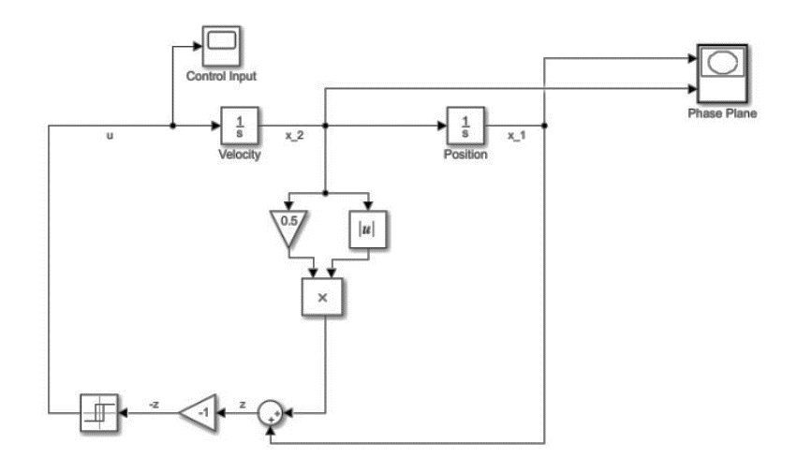
Simulink Model

Slide 20
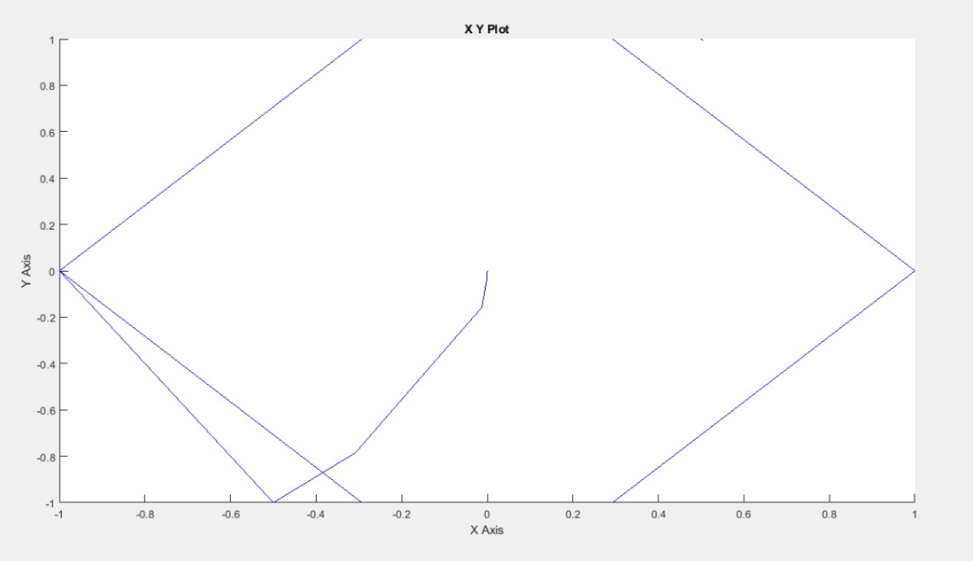
Simulink Result (Phase Plane Plot)

Slide 21
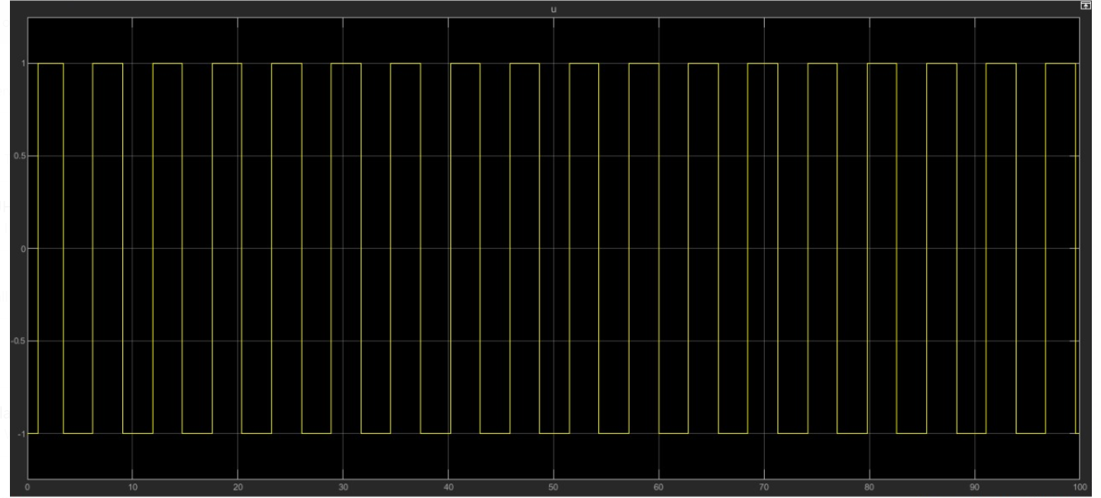
Control Input

Slide 22

Implementation in MATLAB
System:
Given a double integral system as:
$\dot{x_{1}}=x_{2}\left(t\right)$
$\dot{x_{2}}=u\left(t\right)$
Minimize the final time:
$T=\int_{0}^{t_{f}}{0.1∗u^{2}}$
Condition:
$x_{1}\left(0\right)=0, x_{2}\left(0\right)=0, x_{1}\left(2\right)=5, x_{2}\left(2\right)=5$

Slide 23
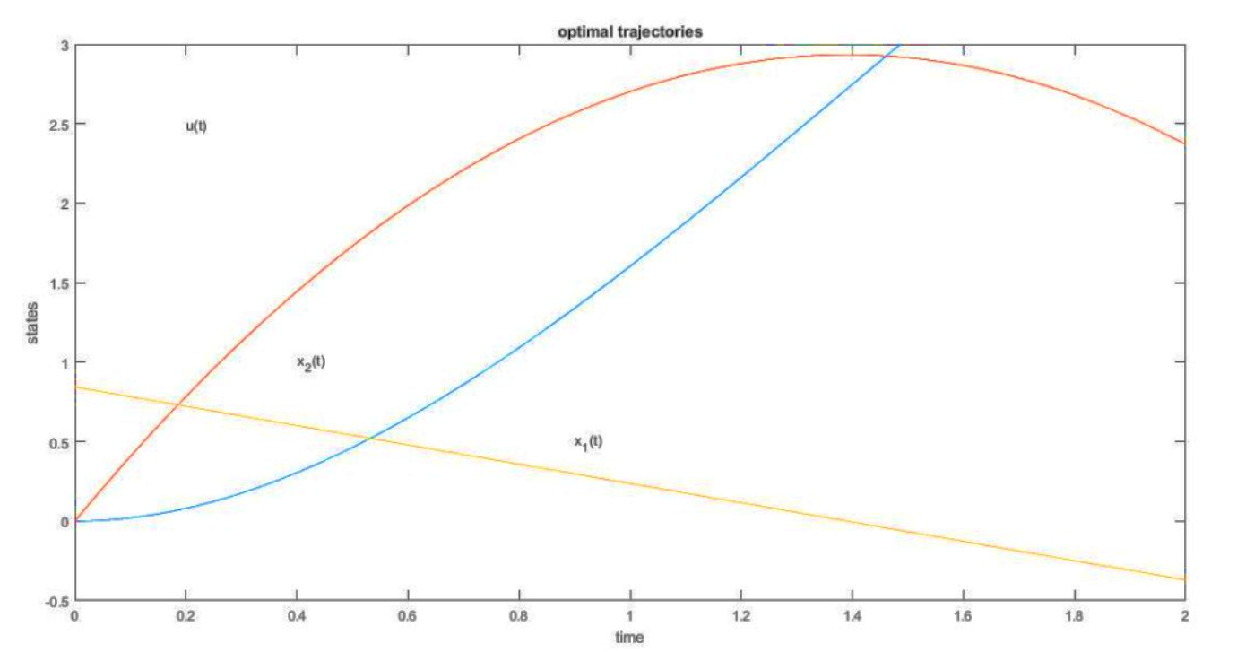
MATLAB Result (Optimal Trajectories)

Slide 24

Implementation in MATLAB
System
Given a double integral system as:
$\dot{x_{1}}=x_{2}\left(t\right)$
$\dot{x_{2}}=u\left(t\right)$
Minimize the final time:
$T=\int_{0}^{t_{f}}{dt}$
To drive the states to the origin:
$x\left(0\right)=[\begin{matrix}2 & 2\end{matrix}]^{T}$, ${x(t}_{f})=[\begin{matrix}0 & 0]^{T}\end{matrix}$, $|u|≤1$

Slide 25
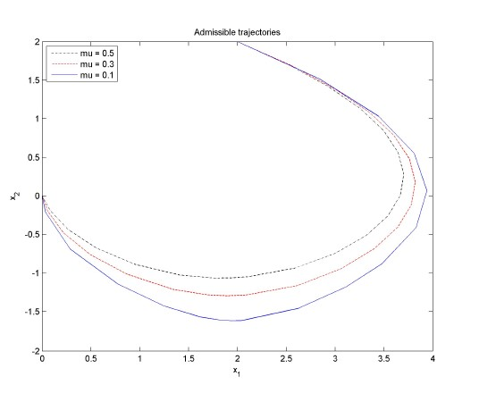
MATLAB Results
Admissible Trajectories

Slide 26
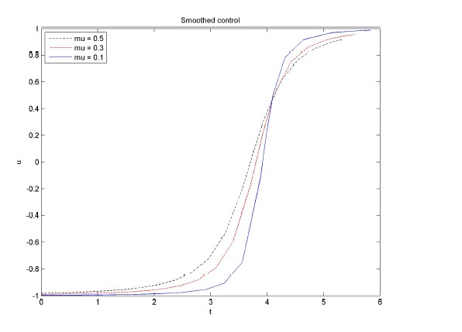
MATLAB Results
Smoothed Control

Slide 27
Application:
We can apply our Mathematical model also in the automobile sector.
This algorithm with bang-bang control can also be used for collision avoidance.
This problem have a lot of scope in robotics and aerospace engineering.
Pontryagin maximum principle along with three different strategies can also be used for the modelling and optimal control of typhoid fever disease.
This algorithm also proved to be efficient to land prob on mars.

Slide 28
Product Quality:
The algorithm that we used is more computationally efficient.
We can stop or start our algorithm when desired state is reached in minimum time.
There is a hope to minimize the energy in order to stop the train in the future through our problem.

Slide 29
Conclusion
In this project it was presented one of the examples of optimal control which is the application of Pontryagin maximum principle and bang-bang control.
We provided the theoretical and mathematical explanation of the problem.
In the first stage we minimized the time which is also our cost function using Pontryagin maximum principle then we derive the equation of optimal trajectories. In second stage we gave the more detailed mathematical explanation. Finally, we implemented this mathematical model in Simulink and MATLAB in order to validate our algorithm and to get the more practical exposure.
Future scope: We can further improve our problem by taking one more factor i.e. energy into the consideration for minimization which will impact the dynamical system quite heavily.

Slide 30
References
Theory
https://link.springer.com/chapter/10.1007/978-3-662-06404-7_13
http://www.bcamath.org/documentos_public/courses/Course_Loheac.pdf
http://solmaz.eng.uci.edu/Teaching/MAE274/SolvingOptContProb_MATLAB.pdf
https://core.ac.uk/download/pdf/82825015.pdf
http://www4.hcmut.edu.vn/~nttien/Lectures/Optimal%20Control/C.11%20Bang-bang%20Control.pdf
http://www.egwald.ca/optimalcontrol/rocketcar.php
MATLAB & Simulink
https://github.com/wanxinjin/Pontryagin-Differentiable-Programming
https://it.mathworks.com/company/newsletters/articles/6-steps-to-an-on-off-controller-using-stateflow.html
https://mec560sbu.github.io/2016/09/25/Opt_control/
https://moodle.fel.cvut.cz/course/view.php?id=5716

Slide 31
T
H
A
N
K
Y
O
U

